Slide 1
Form表单
除了Bootstrap中的表单控件外其他的功能控件

Slide 2
滚动条

Slide 3
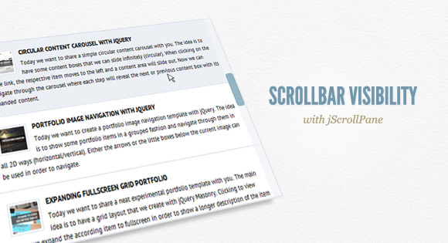
Scrollbar Visibility with jScrollPane
http://tympanus.net/codrops/2011/09/30/scrollbar-visibility-with-jscrollpane/

Slide 4
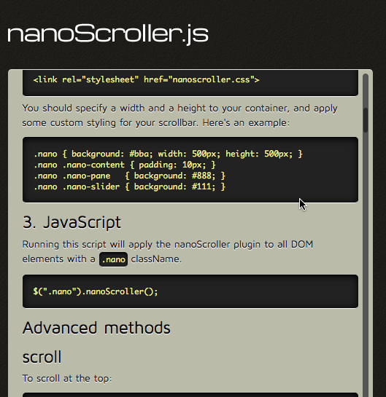
nanoScrollerJS
http://jamesflorentino.github.io/nanoScrollerJS/

Slide 5
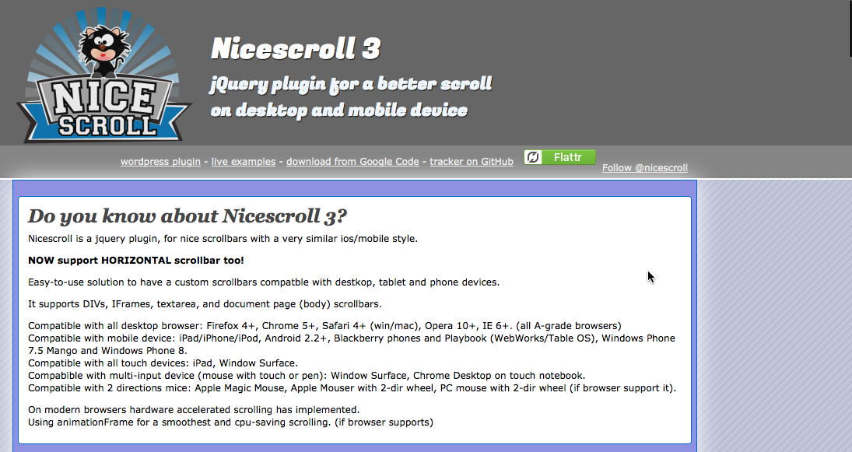
jquery.nicescroll
http://nicescroll.areaaperta.com/

Slide 6

jQuery custom content scroller
http://manos.malihu.gr/jquery-custom-content-scroller/

Slide 7
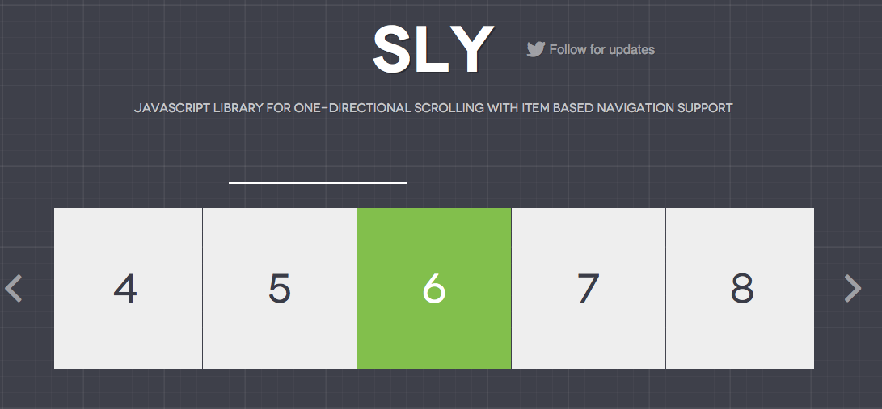
Sly
http://darsa.in/sly/

Slide 8
滑动条

Slide 9
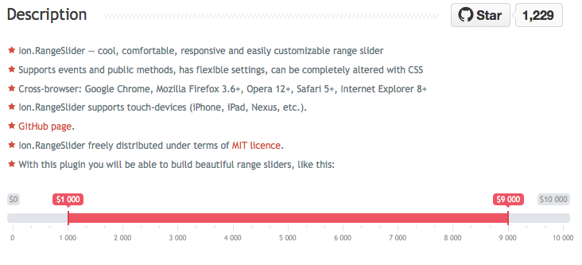
ion.rangeSlider
http://ionden.com/a/plugins/ion.rangeSlider/en.html

Slide 10
表单验证

Slide 11
表单验证
jQuery Validation Plugin
http://jqueryvalidation.org/

Slide 12
下拉菜单

Slide 13
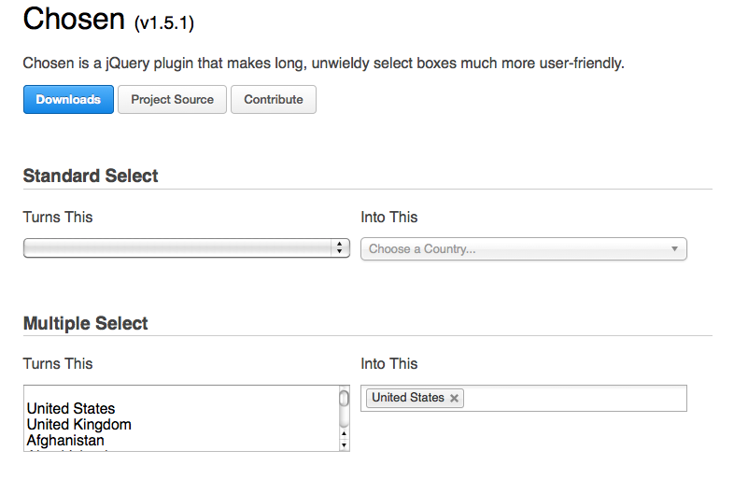
Chosen
https://harvesthq.github.io/chosen/

Slide 14

Custom Drop-Down List Styling
http://tympanus.net/codrops/2012/10/04/custom-drop-down-list-styling/

Slide 15
工具栏

Slide 16
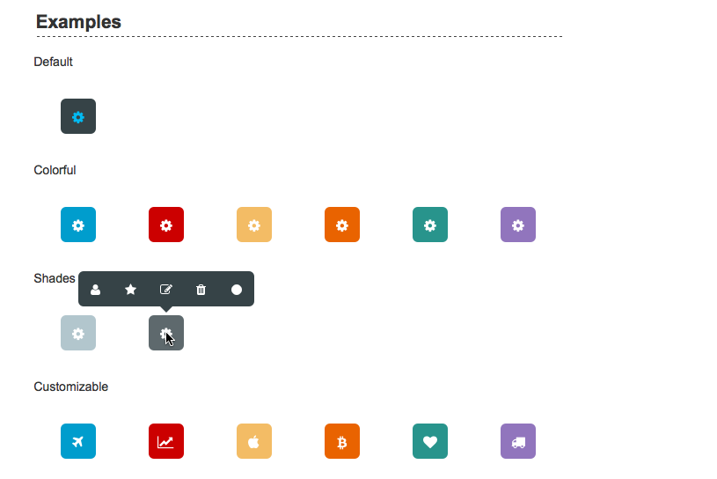
Toolbar.Js
http://paulkinzett.github.io/toolbar/

Slide 17
checkbox

Slide 18
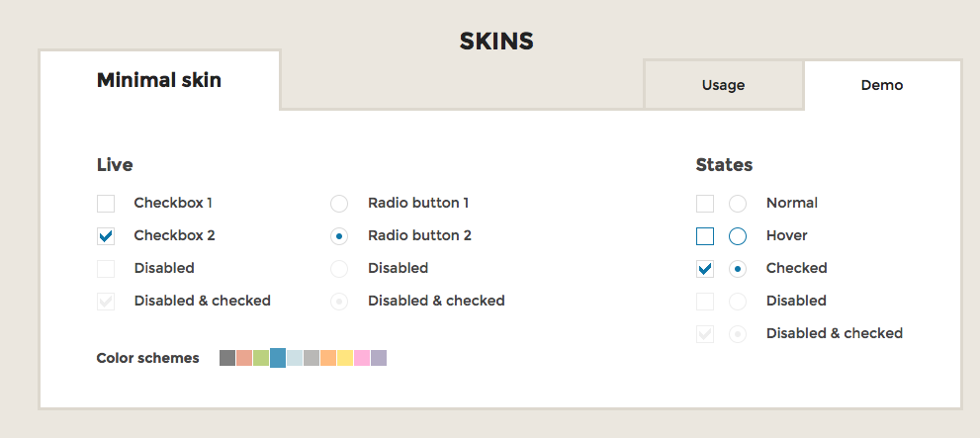
iCheck
http://icheck.fronteed.com/

Slide 19
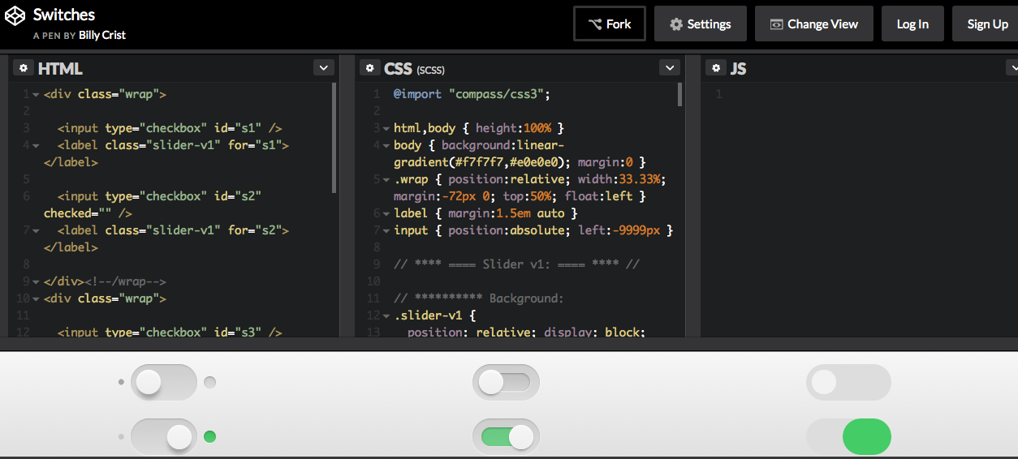
Switches
http://codepen.io/billycrist/pen/CHmiE

Slide 20
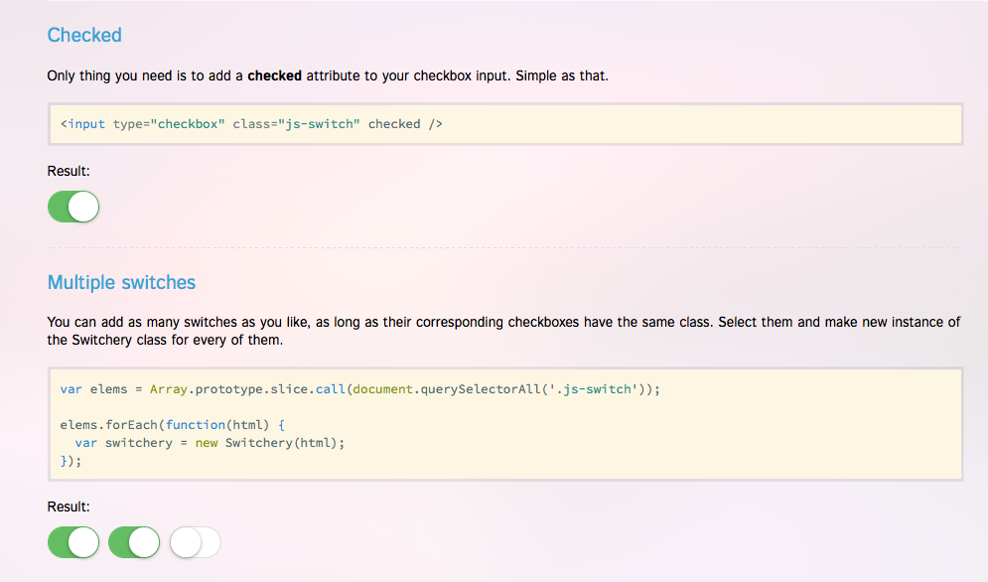
Switchery
http://abpetkov.github.io/switchery/

Slide 21
列表筛选

Slide 22
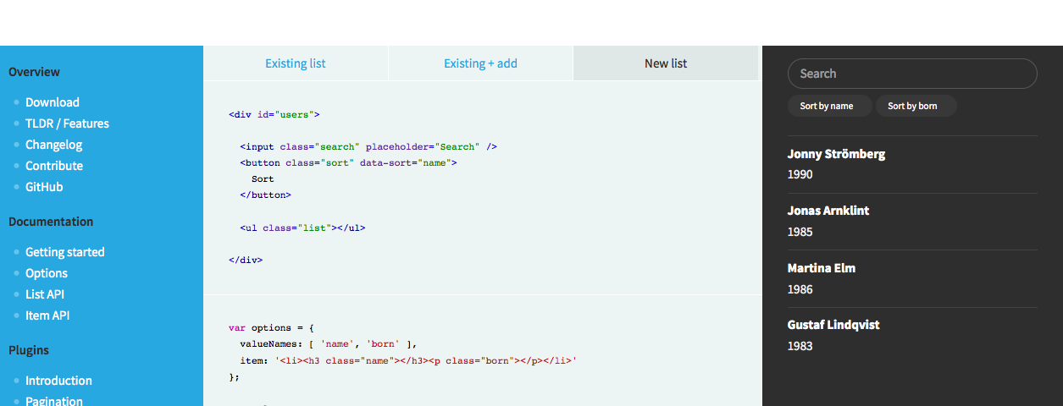
List.js
http://www.listjs.com/

Slide 23
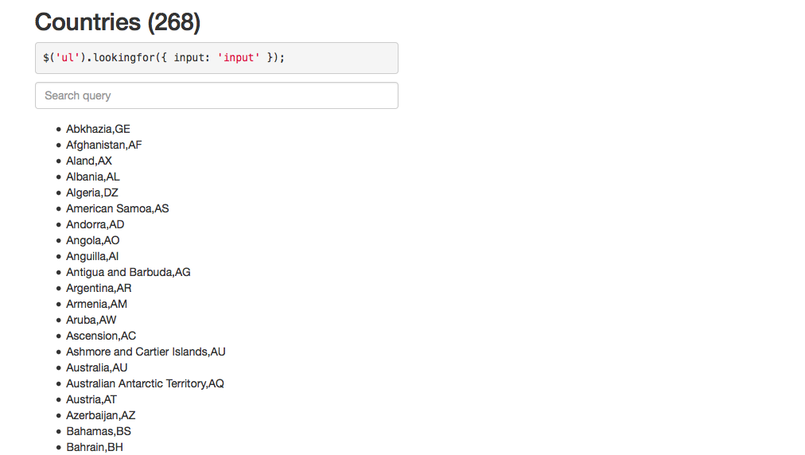
Looking For
http://albburtsev.github.io/jquery.lookingfor/

Slide 24
二维码

Slide 25
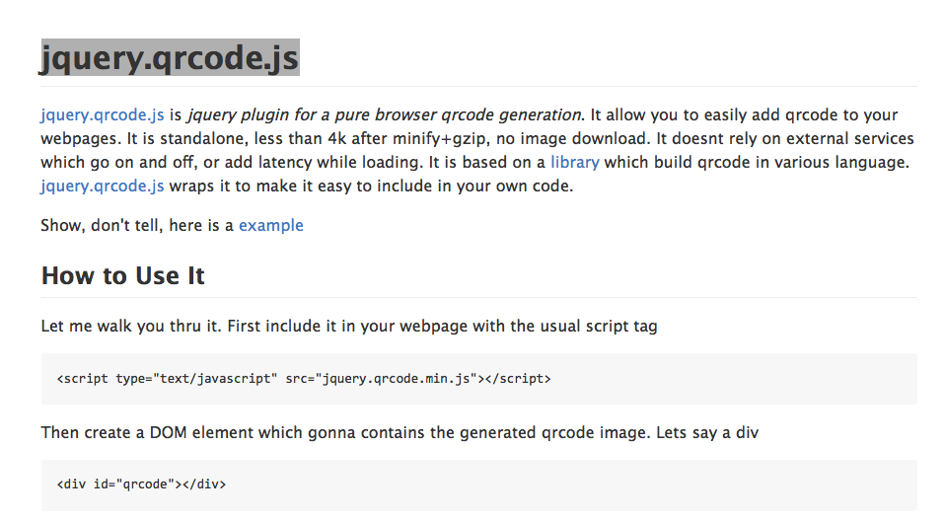
jquery.qrcode.js
https://github.com/jeromeetienne/jquery-qrcode

Slide 26
分页

Slide 27
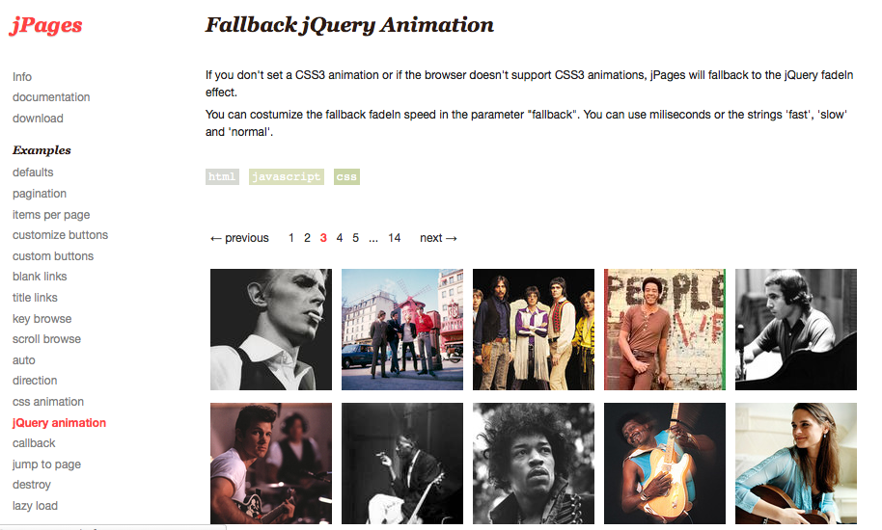
jPages
http://luis-almeida.github.io/jPages/jqueryanimation.html

Slide 28
环形时间

Slide 29
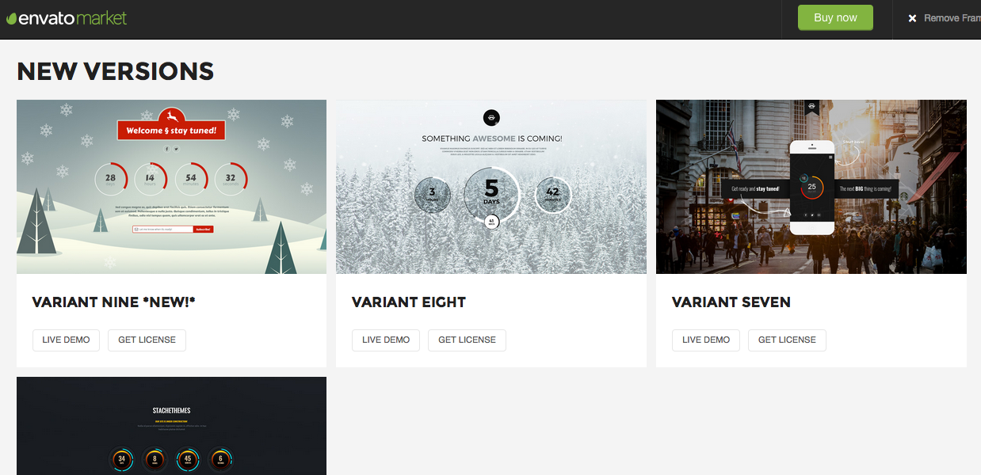
Circular Countdown
https://codecanyon.net/item/circular-countdown/3100472?ref=lvraa

Slide 30
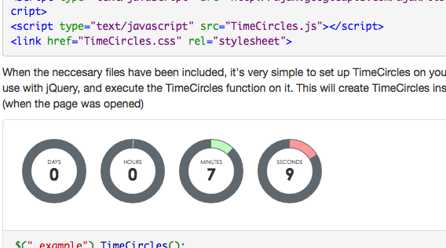
Time Circles
http://git.wimbarelds.nl/TimeCircles/readme.php

Slide 31
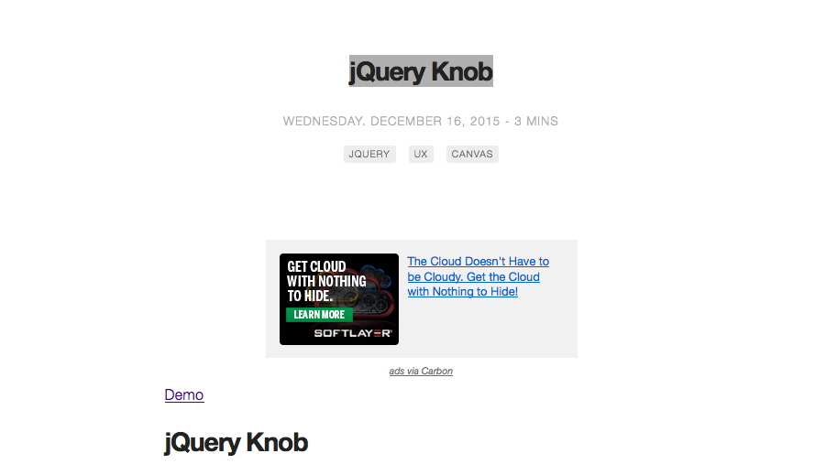
jQuery Knob
http://anthonyterrien.com/knob/

Slide 32
倒计时

Slide 33
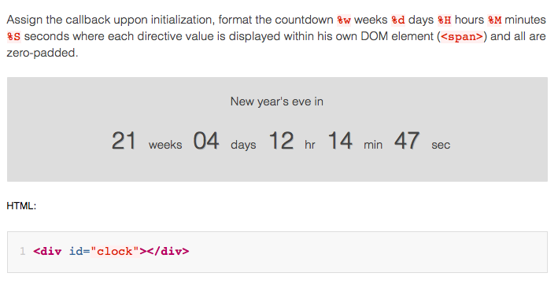
jQuery.countdown
https://github.com/hilios/jQuery.countdown

Slide 34
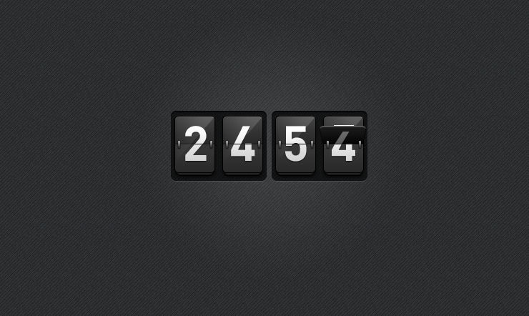
jquery-countdown
https://github.com/Reflejo/jquery-countdown

Slide 35
时间轴

Slide 36
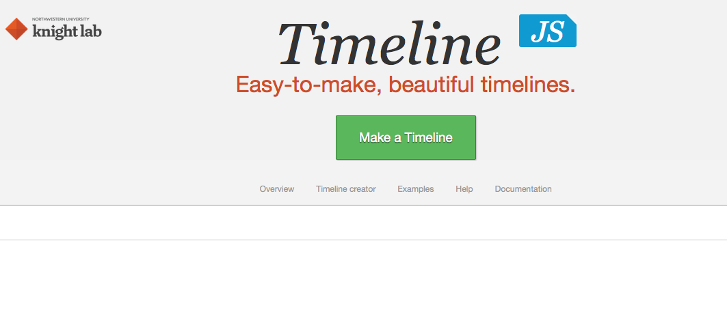
Timeline
http://timeline.knightlab.com/

Slide 37
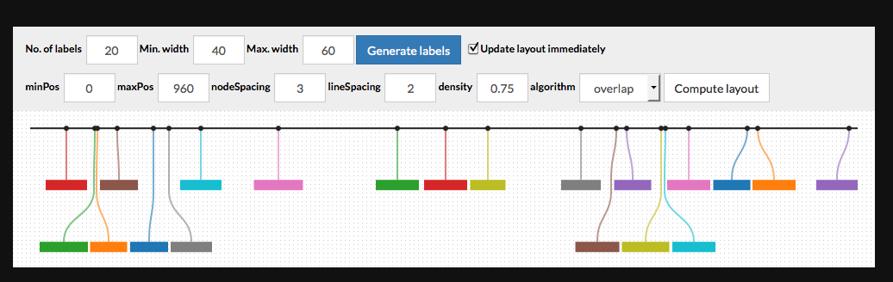
labella.js
https://github.com/twitter/labella.js

Slide 38
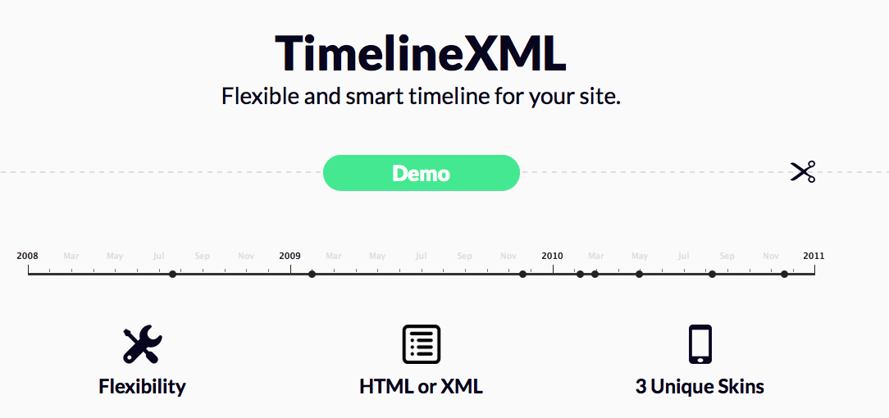
TimelineXML
http://preview.codecanyon.net/item/jquery-timelinexml/full_screen_preview/1448100

Slide 39
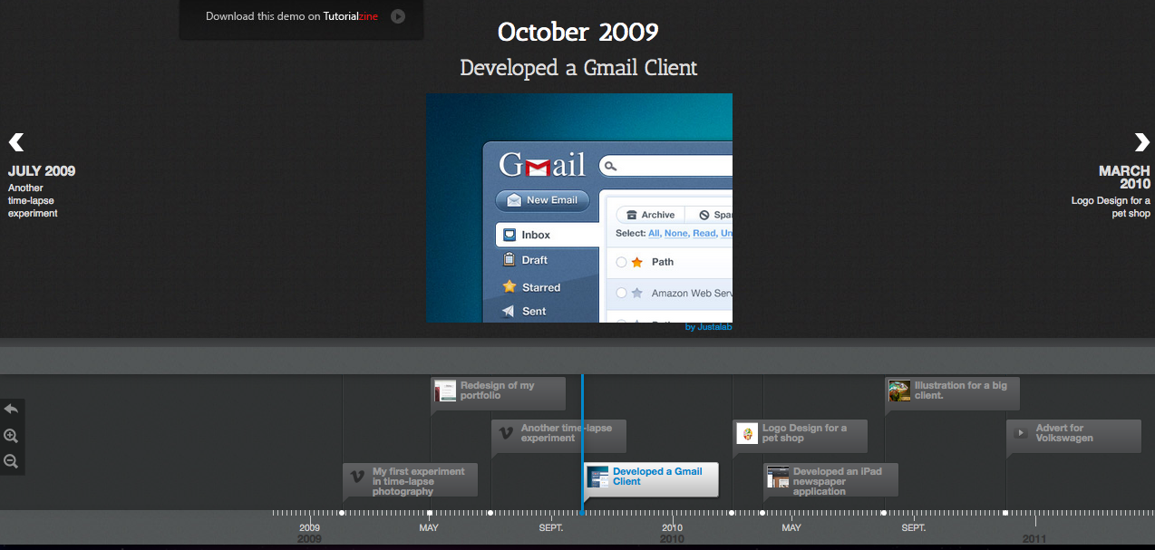
Timeline Portfolio with jQuery and CSS3
http://jquery-plugins.net/timeline-portfolio-with-jquery-and-css3

Slide 40
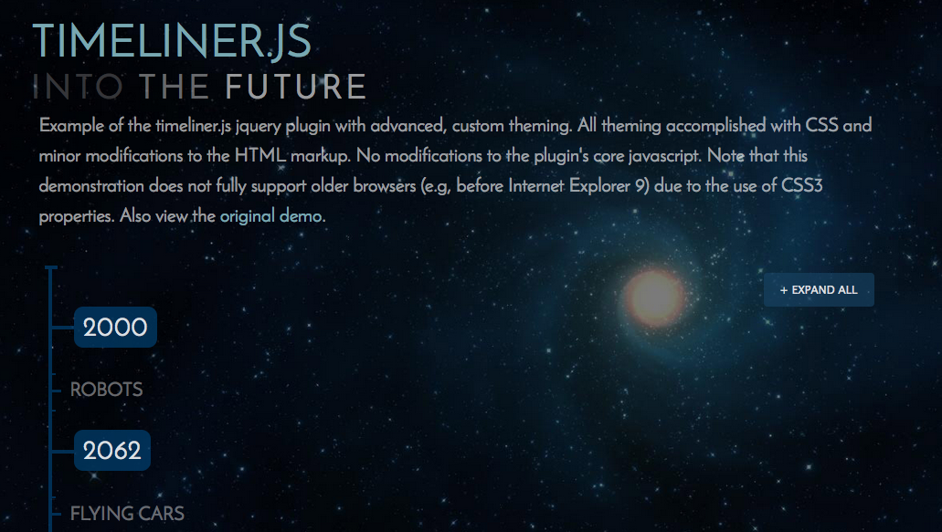
Timeliner.js
http://jquery-plugins.net/timeliner-js-jquery-plugin-for-making-simple-historical-timelines

Slide 41
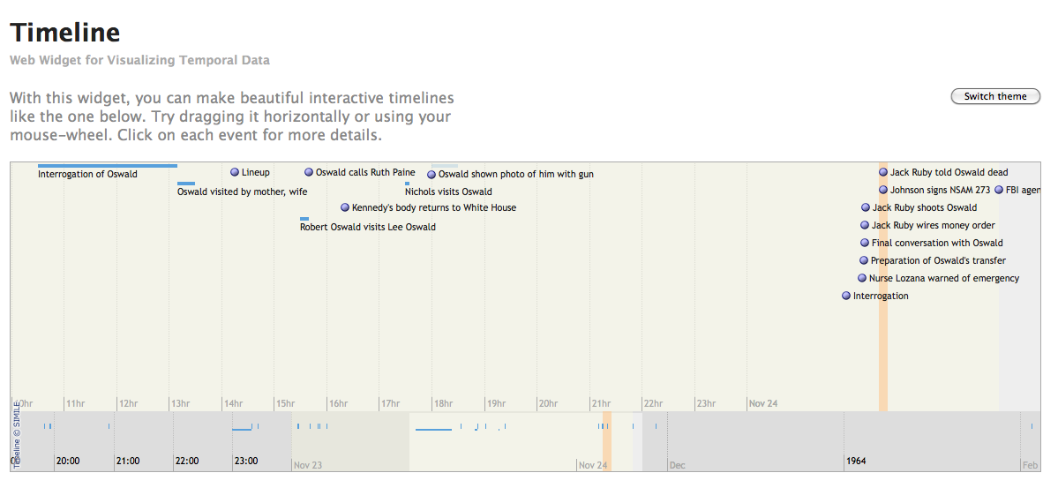
Timeline
http://www.simile-widgets.org/timeline/

Slide 42
文本输入框

Slide 43
输入提示，自动完成
typeahead.js
https://github.com/twitter/typeahead.js
Awesomplete
http://leaverou.github.io/awesomplete/
places
https://github.com/algolia/places

Slide 44
Tags Input
jQuery Tags Input
(https://github.com/xoxco/jQuery-Tags-Input)
Bootstrap Tags Input
http://bootstrap-tagsinput.github.io/bootstrap-tagsinput/examples/

Slide 45
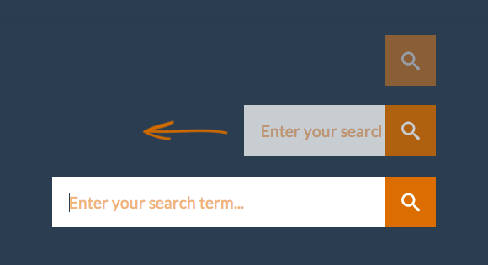
Expanding Search Bar Deconstructed
http://tympanus.net/codrops/2013/06/26/expanding-search-bar-deconstructed/

Slide 46
按钮

Slide 47
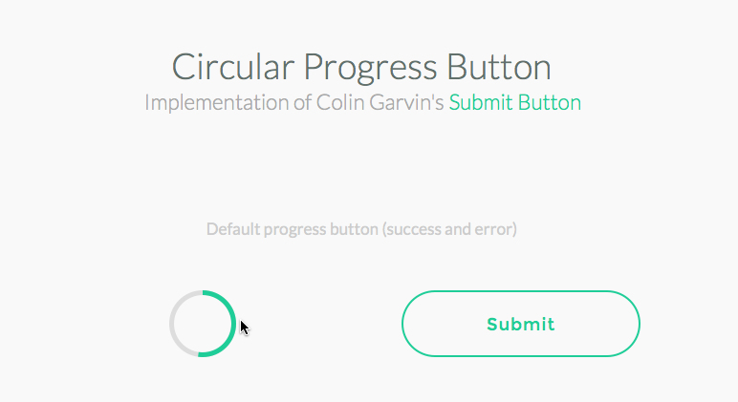
Circular Progress Button
http://tympanus.net/Tutorials/CircularProgressButton/

Slide 48

Button Switches with Checkboxes and CSS3 Fanciness
http://tympanus.net/codrops/2012/09/13/button-switches-with-checkboxes-and-css3-fanciness/

Slide 49
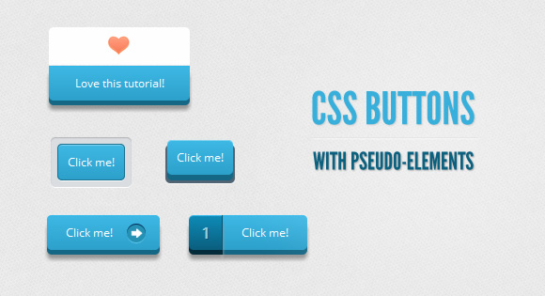
CSS Buttons with Pseudo-elements
http://tympanus.net/codrops/2012/01/11/css-buttons-with-pseudo-elements/

Slide 50
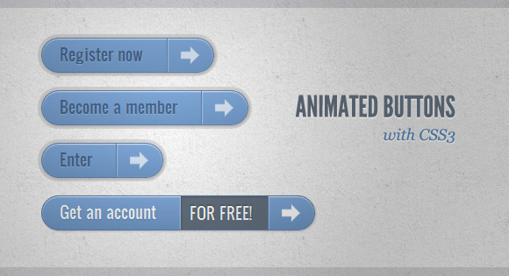
Animated Buttons with CSS3
http://tympanus.net/codrops/2011/11/07/animated-buttons-with-css3/

Slide 51

纯CSS3 3D按钮
http://www.html5tricks.com/css3-3d-milk-style-button.html

Slide 52
Text Editor

Slide 53
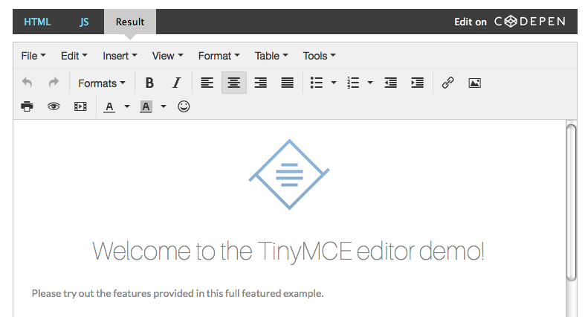
tinymce
https://www.tinymce.com/

Slide 54
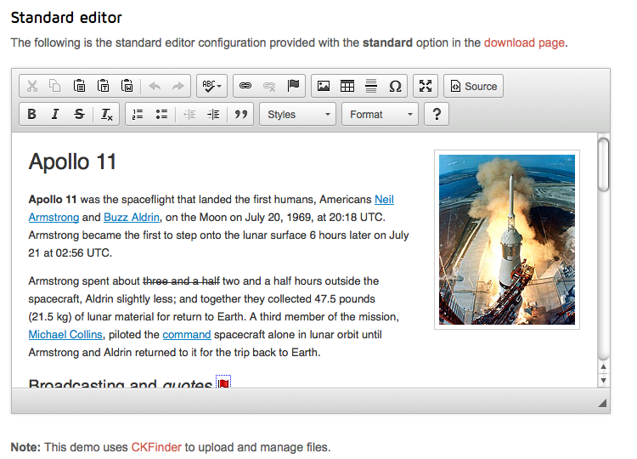
ckeditor
http://ckeditor.com/download

Slide 55
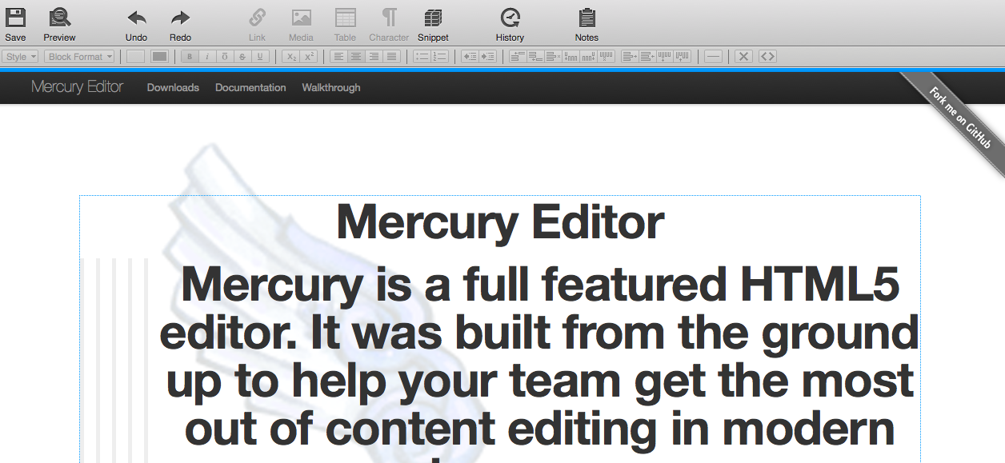
Mercury Editor
https://github.com/jejacks0n/mercury

Slide 56
文件上传

Slide 57
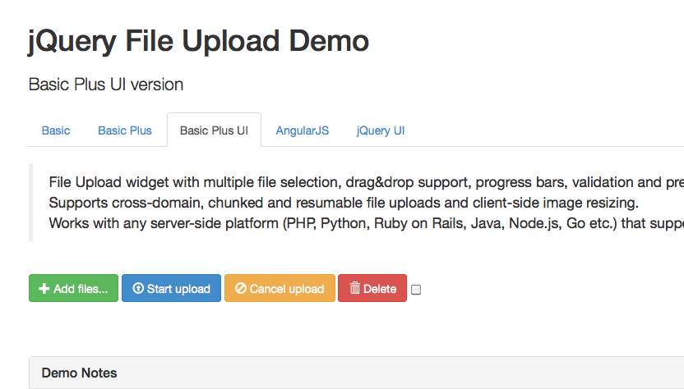
jQuery File Upload
https://github.com/blueimp/jQuery-File-Upload

Slide 58
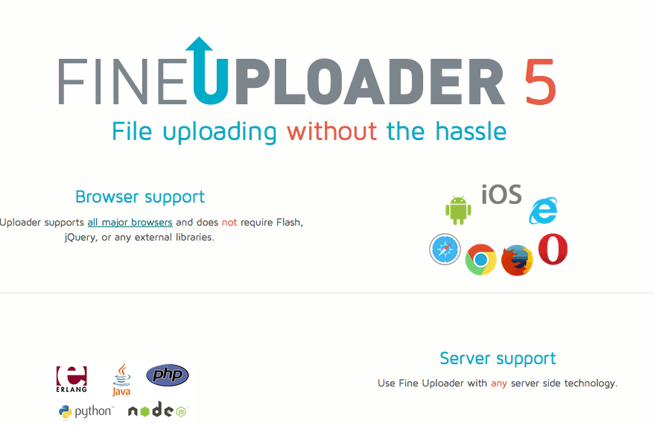
fineuploader
http://fineuploader.com/#collapseOne

Slide 59
进度条

Slide 60
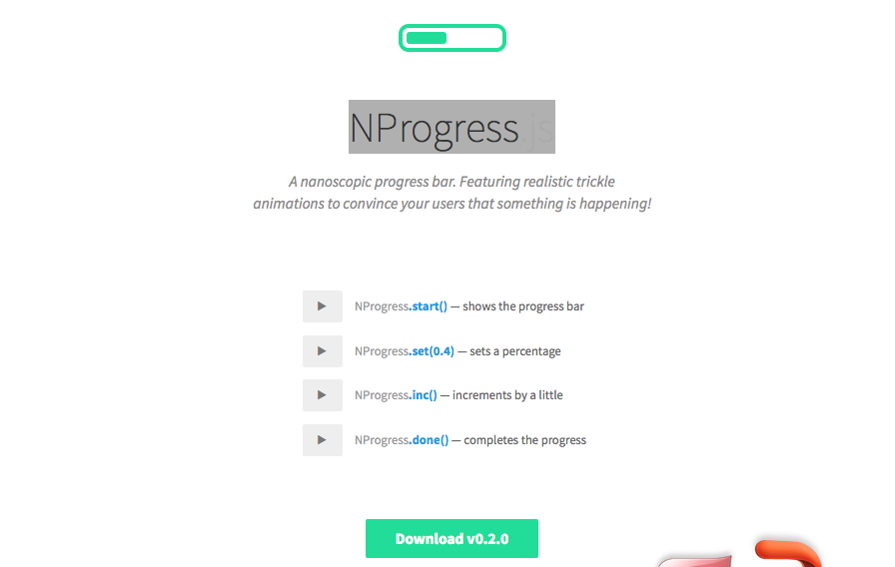
NProgress.js
http://ricostacruz.com/nprogress/

Slide 61
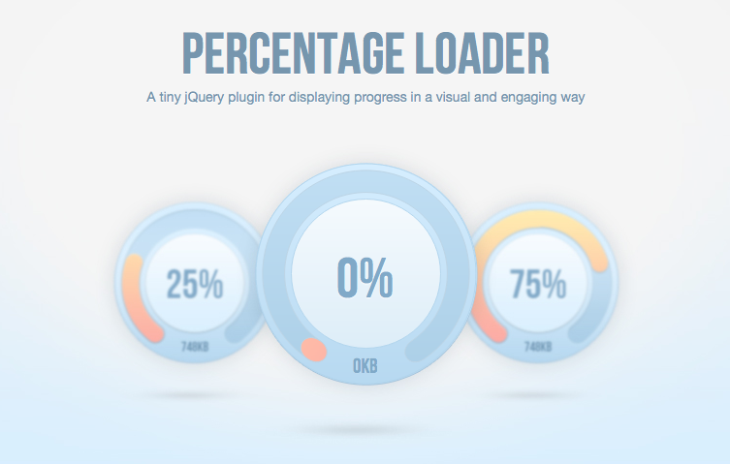
Percentage Loader
http://widgets.better2web.com/loader/

Slide 62
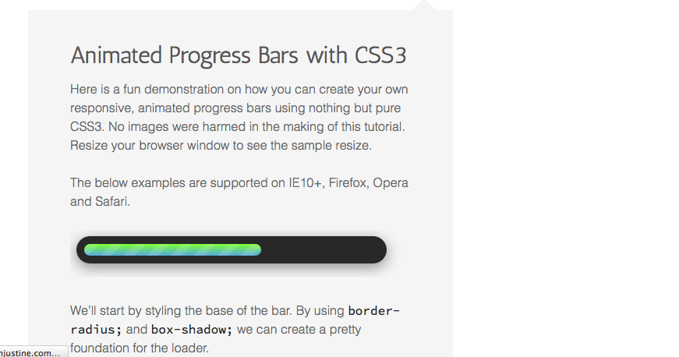
Animated Progress Bars with CSS3
http://sarahjustine.com/2013/03/24/animated-progress-bars-with-css3-2/

Slide 63
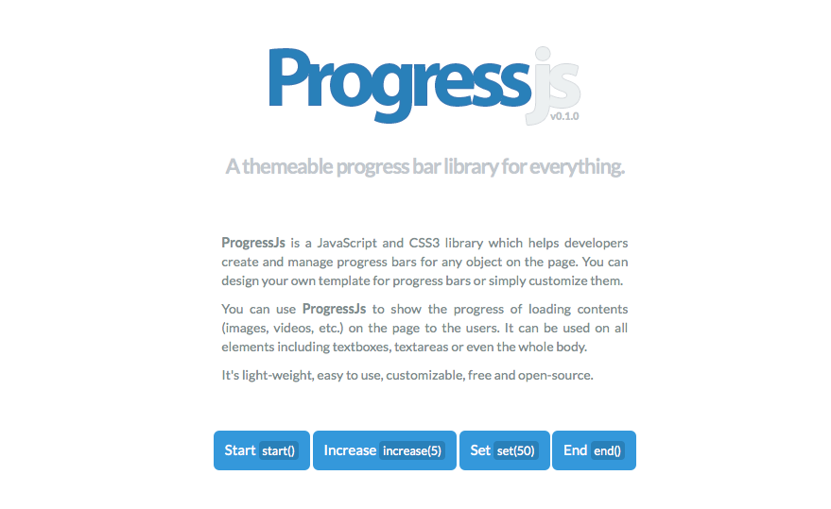
progress.js
http://usablica.github.io/progress.js/

Slide 64
pace
https://github.com/HubSpot/pace

Slide 65
选择日期时间

Slide 66
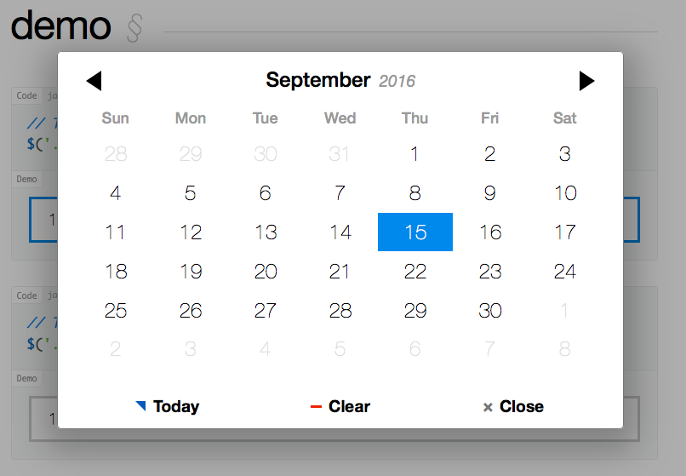
pickadate
http://amsul.ca/pickadate.js/

Slide 67
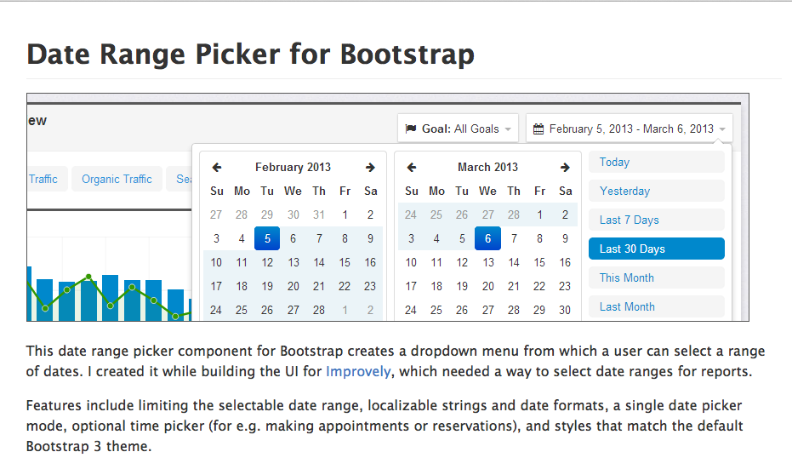
Date Range Picker for Bootstrap
https://github.com/dangrossman/bootstrap-daterangepicker

Slide 68
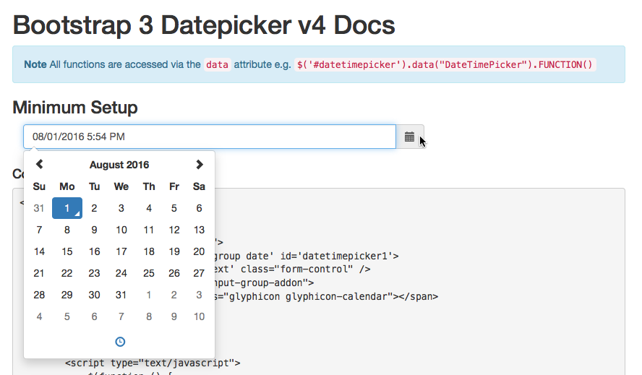
Bootstrap 3 Datepicker v4 Docs
http://eonasdan.github.io/bootstrap-datetimepicker/

Slide 69
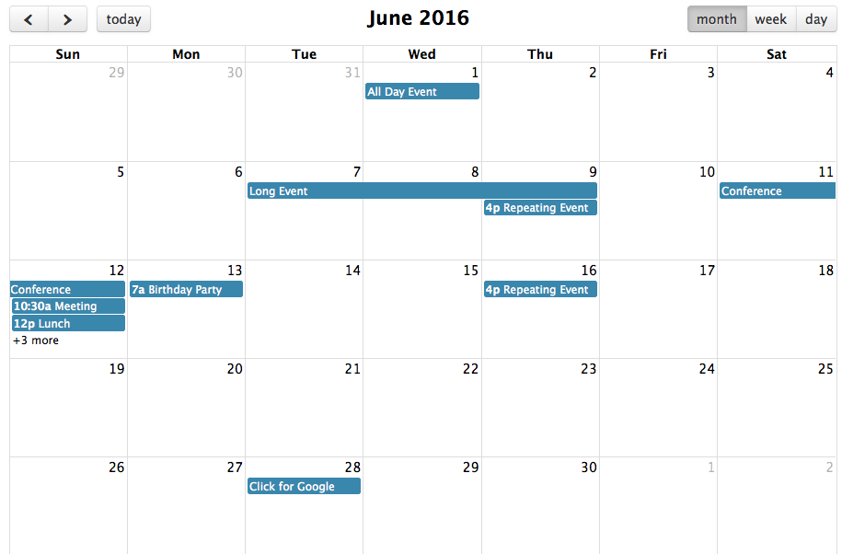
Fullcalendar
https://github.com/fullcalendar/fullcalendar

Slide 70

Calendario
http://tympanus.net/codrops/2012/11/27/calendario-a-flexible-calendar-plugin/

Slide 71
移动组件

Slide 72
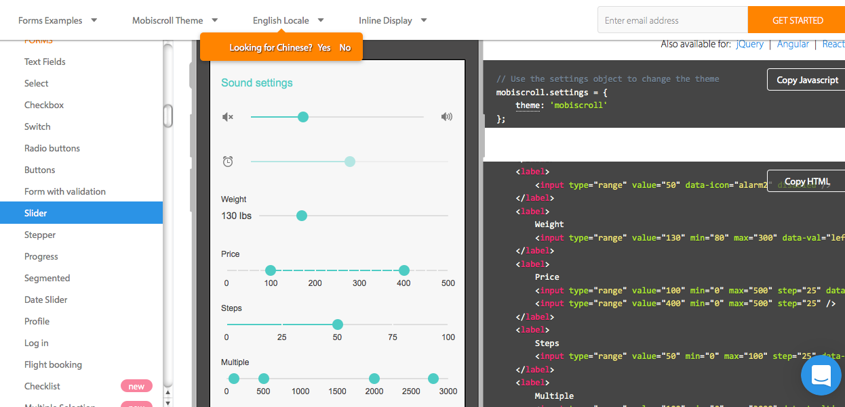
mobiscroll
https://www.mobiscroll.com/

Slide 73
综合效果

Slide 74
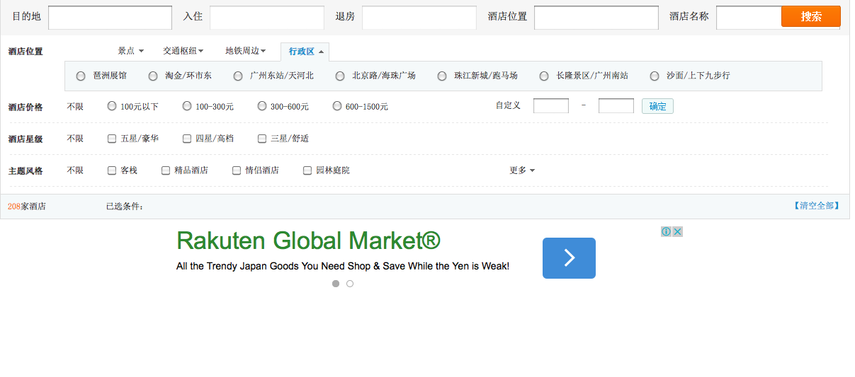
多条件筛选插件
http://js.itivy.com/?p=1211

Slide 75
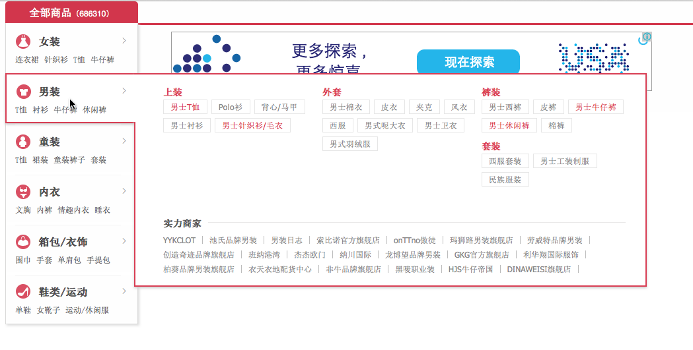
网上商城左侧分类下拉菜单
http://js.itivy.com/?p=1203

Slide 76
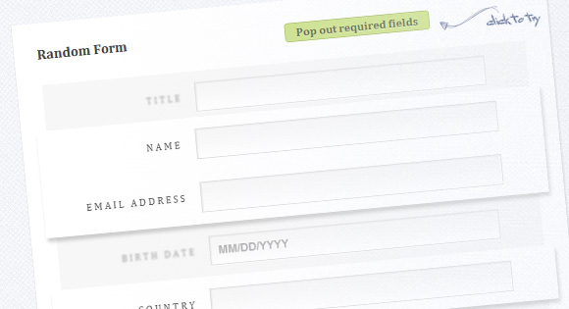
Enhance Required Form Fields with CSS3
http://tympanus.net/codrops/2012/05/02/enhance-required-form-fields-with-css3/

Slide 77

Natural Language Form with Custom Input Elements
http://tympanus.net/codrops/2013/05/21/natural-language-form-with-custom-input-elements/

Slide 78
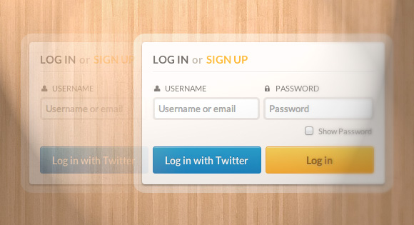
Custom Login Form Styling
http://tympanus.net/codrops/2012/10/16/custom-login-form-styling/

Slide 79
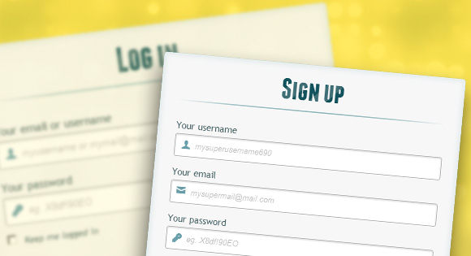
Login and Registration Form with HTML5 and CSS3
http://tympanus.net/codrops/2012/03/27/login-and-registration-form-with-html5-and-css3/

Slide 80
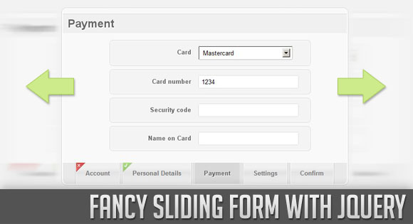
Fancy Sliding Form with jQuery
http://tympanus.net/codrops/2010/06/07/fancy-sliding-form-with-jquery/

Slide 81

Animated Form Switching with jQuery
http://tympanus.net/codrops/2011/01/06/animated-form-switching/

Slide 82
提醒通知

Slide 83
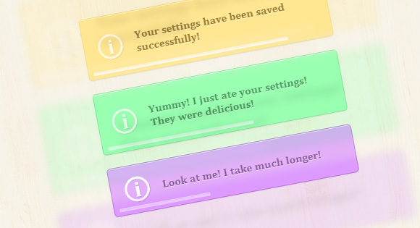
Timed Notifications with CSS Animations
http://tympanus.net/codrops/2012/06/25/timed-notifications-with-css-animations/

Slide 84
动态Banner

Slide 85

Animated Web Banners With CSS3
http://tympanus.net/codrops/2012/01/10/animated-web-banners-with-css3/

